Slide 1
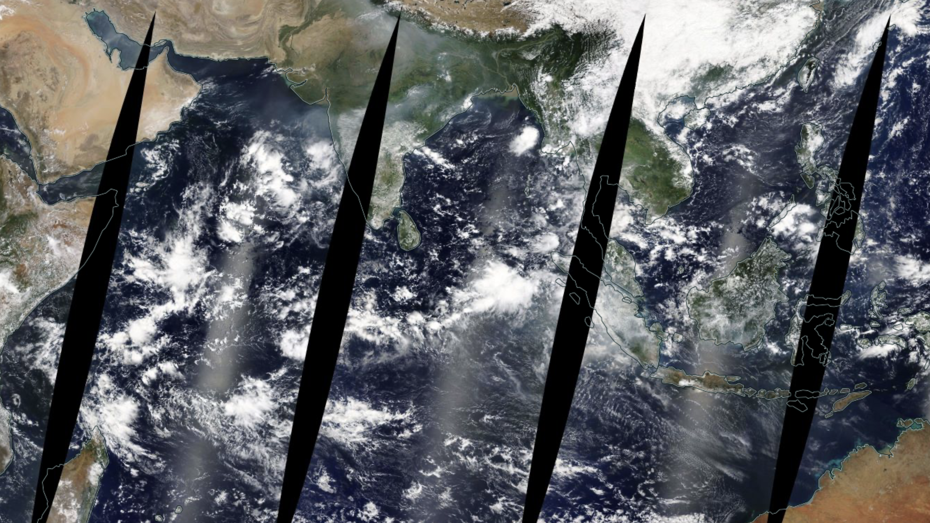
NASA MODIS IMAGERY CLOUD IDENTIFICATION
Dongwei Fu
DTSA-5506
University of Colorado, Boulder

Slide 2
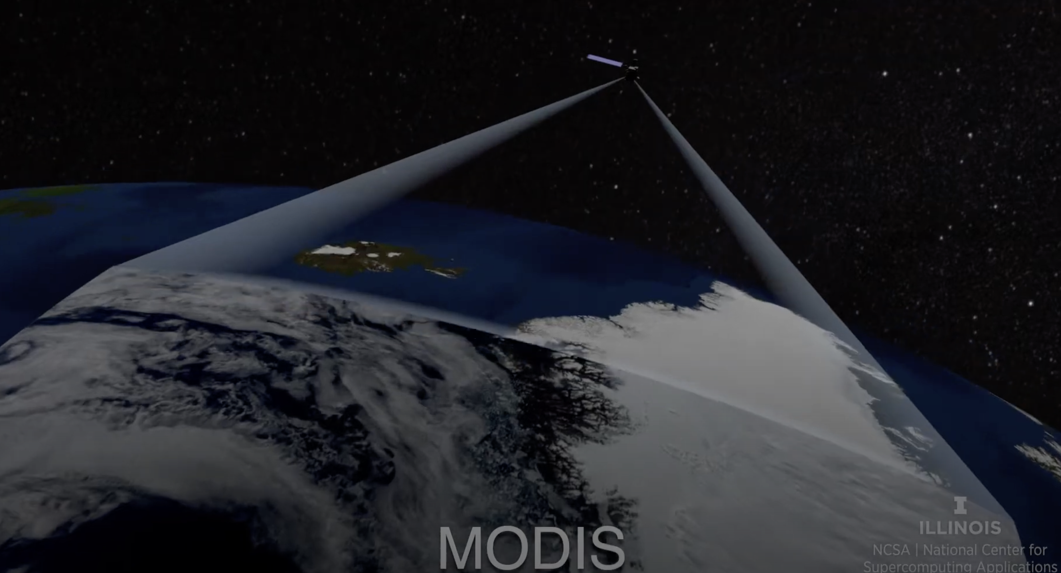
Outline
Problem Statement
Related work
Model setup
Evaluation
Discussion
Conclusion
CC. NCSA, University of Illinois

Slide 3
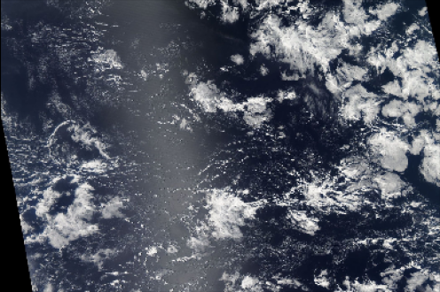
Problem statement
Clouds play a critical role in regulating Earth’s climate by reflecting sunlight and trapping heat.
Small changes in shallow clouds properties (thickness, coverage) significantly impact the Earth’s climate.
Understanding shallow clouds is essential for improving climate model predictions of future climate.
Satellite Imagery provides extensive spatial and temporal coverage of clouds, especially in remote regions.
Manual analysis of satellite cloud images is time-consuming; machine learning can automate cloud classification.
Goal: Develop a Convolutional Neural Network (CNN) to identify various satellite cloud structures.
NASA Aqua MODIS 250m RGB image, from NASA WorldView.

Slide 4
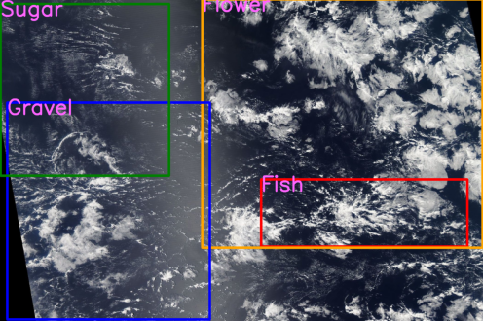
Related Work: Satellite image dataset
Kaggle competition dataset (Rasp et al. 2019) Human labeled MODIS RGB image from NASA worldview web-interface. (https://worldview.earthdata.nasa.gov)
Consists of four cloud classes:
Sugar: dusting of fine clouds with little self-organization
Flower: large-scale stratiform clouds in bouquets with separations form each other.
Fish: large-scale skeletal networks that are separated from other cloud formations.
Gravel: arcs of randomly interacting cells with granularity.
(Rasp et al. 2020)
Training dataset image '015aa06.jpg'

Slide 5
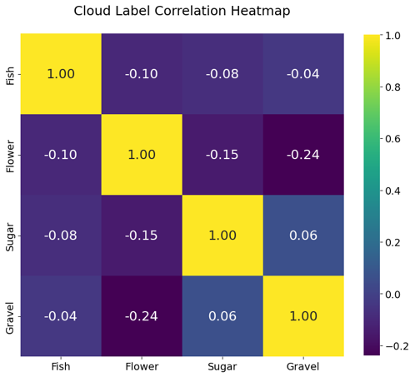
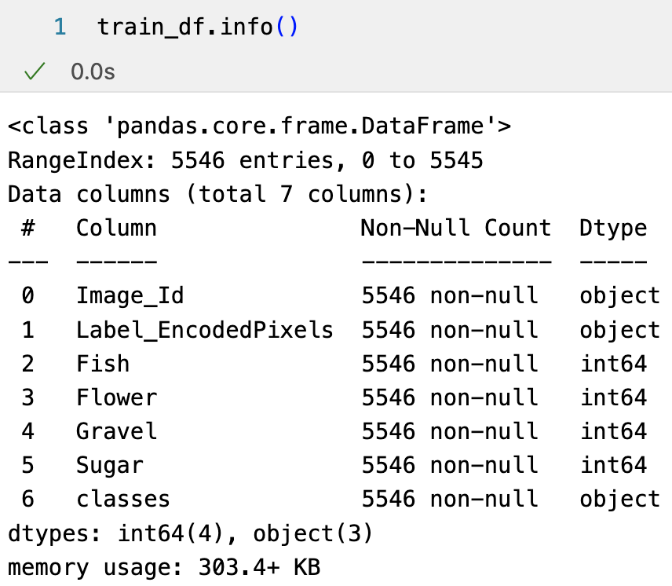
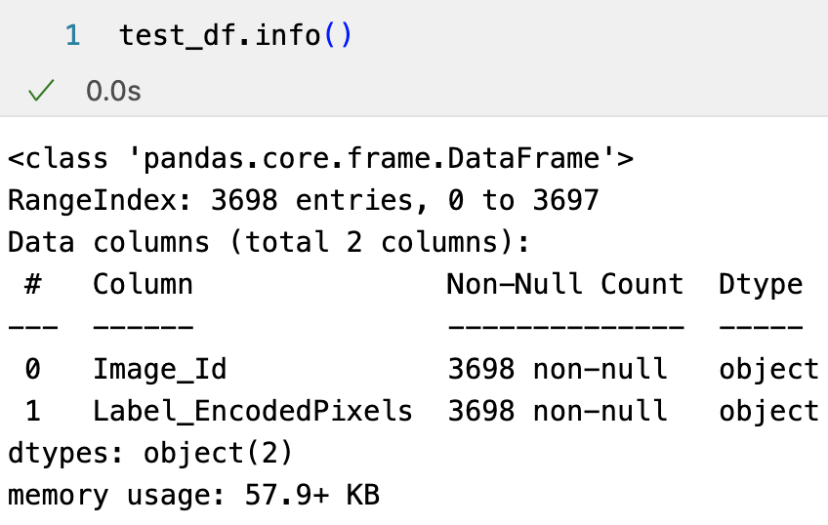
Related Work: Exploratory Data Analysis
Training dataset: 5546 RGB images
Test dataset: 3698 RGB images.
4 cloud classes:
Sugar, Flower, Fish, Gravel.
Training label relative frequency
Training label valid mask frequency

Slide 6
Related Work: Data preprocessing
Data augmentation: Images at 1400 x 2100 pixels resolution can be computational for heavy model training. To improve training efficiency, data augmentation from Albumentation was used to split data into batches, perform image resizing, horizontal and vertical flips and random rotation.
Run-length encoding (RLE): To reduce submission file sizes, pixel run-length encoding was implemented to record start position and run length of the masked image pixels.

Slide 7
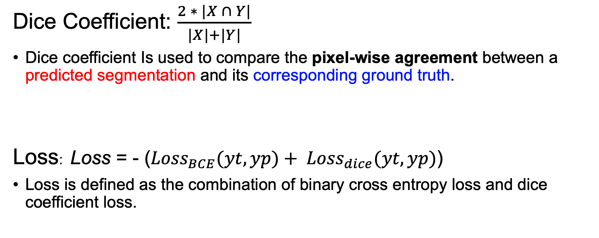
Related Work: Evaluation Metrics
Dice Coefficient: $\frac{2 ∗ |X ∩ Y|}{|X|+|Y|}$
Dice coefficient Is used to compare the pixel-wise agreement between a predicted segmentation and its corresponding ground truth.
Loss: Loss = - (${Loss}_{BCE}(yt, yp)+ {Loss}_{dice}(yt, yp)$)
Loss is defined as the combination of binary cross entropy loss and dice coefficient loss.

Slide 8
Related Work: Segmentation Models
U-Net architecture: Encoder + Decoder Network. Encoder compress input image via downsampling; Decoder upsamples the compressed features and restores original spatial resolution.
Combined with other efficient encoder models, such as EfficientNet and ResNet to form a hybrid U-Net model architecture that are widely used in image segmentation.
320 x 480 x 3
Output Image
Input Image
320 x 480 x 3
Conv2D 3x3
Conv2D
160 x 240 x 32
40 x 60 x 40
320 x 480 x 16
Block 1
MBConv
Block 2
MBConv
Block 3
MBConv
Block 4
MBConv
Concat
Up-Conv2D
Concat
Up-Conv2D
Concat
Up-Conv2D
160 x 240 x 16
80 x 120 x 24
20 x 30 x 80
Block 5
MBConv
Up-Conv2D
20 x 30 x 112
Architecture of EfficientNet-B0 framework from Segmentation Models. Iakubovskii 2019.
Adapted from Ahmed et al. 2021.
Block 6
MBConv
Concat
10 x 15 x 192
20 x 30 x 256
Block 7
MBConv
10 x 15 x 320
Up-Conv2D
Encoder
Decoder

Slide 9
Proposed work and Timeline
Identify the problem and gather information on project feasibility.
Download data and perform EDA analysis
Preprocess data for segmentation model training.
Build initial baseline model and assess model performance.
Fine-tune model / hyperparameter tuning.
Finalize best model.
Analyze final results.
Reach final evaluation/conclusions.
Timeline | 9/1 to 9/15 | 9/16 to 9/30 | 10/1 to 10/10 | 10/10 to 10/15
Action items | Identify problem and choose dataset. EDA analysis, data | Data preprocessing 1.Data augmentation. 2.Data RLE encoding. 3. Data visualization. | 1. Select model architecture and build baseline model. 2. Select alternative model and compare model performance. | Hyperparameter tuning to improve model performance. Finalize analysis. Write project report and presentation.

Slide 10
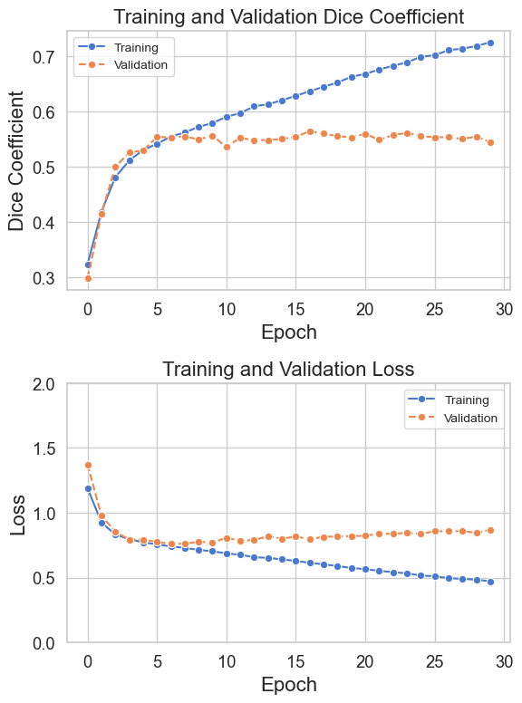
Results: Baseline model run with EfficientNet-B0
Training Dice Coefficient steadily improves throughout the 30 epochs (and the training loss decreases progressively)
Validation Dice Coefficient plateaus early around epoch 6 and shows minimal improvement afterwards (Loss stabilizes after epoch 6).

Slide 11
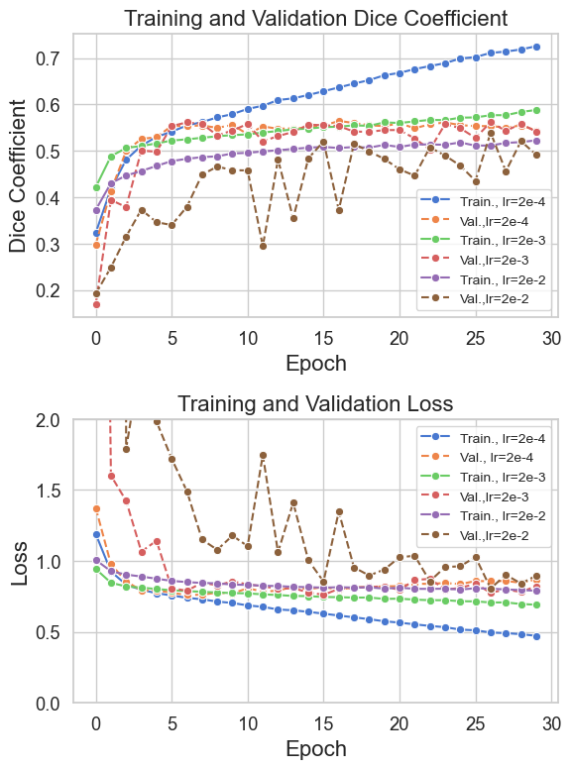
Results: Hyperparameter Tuning on learning rate
learning rate of 2e-4 exhibits the most stable and consistent improvement, both in the Dice Coefficient and loss across training and validation sets.
higher learning rates like 2e-3 and especially 2e-2 lead to more erratic training behavior, suggests that the higher learning rates cause the model to overshoot optimal weights during training, leading to poorer generalization.

Slide 12
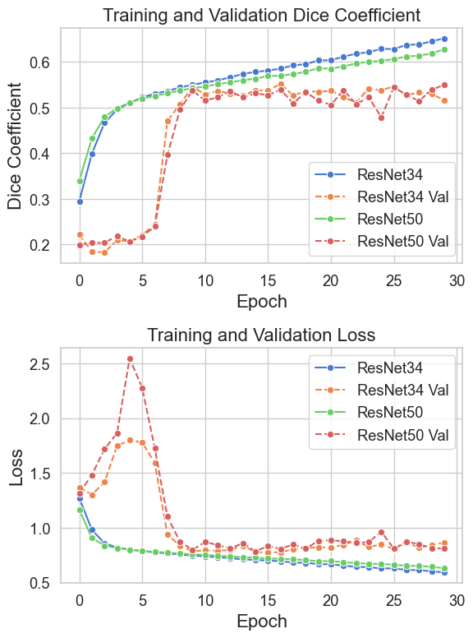
Results: model run with ResNet-34 and ResNet-50
Around 5 epochs, both models reached the peak in model loss, and then the model loss decreases dramatically until becoming stable after ~10 epochs.
In the first few epochs, the model rapidly adjusts weights based on training data. Initially the model’s predictions can be highly erratic as the weights are far from optimal.

Slide 13
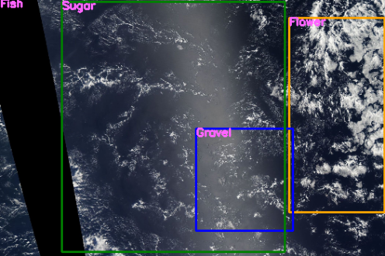
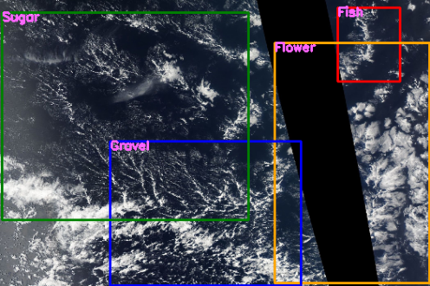
Results: Test cases with predictions from model
Test dataset image ‘db8c669.jpg'
Test dataset image ‘04326a2.jpg'
Consistent behavior between prediction and training dataset:
The masks tend to identify “Flower” and “Fish” well. However, larger overlap between ”Sugar” and “Gravel” labels.

Slide 14
Results: Summary of all model runs
EfficientNet-B0 with a learning rate of 0.0002 achieved the highest training Dice score of 0.726 and lowest training loss of 0.472.
ResNet-50 achived the highest validation Dice score of 0.550 and lowest validation loss of 0.810.
All models seems to perform much better in training.
Backbone Model | Train. DICE | VAL. DICE | TRAIN. Loss | VAL. LOSS
EfficientNetB0 (lr = 0.02) | 0.523 | 0.492 | 0.789 | 0.896
EfficientNetB0 (lr = 0.002) | 0.588 | 0.541 | 0.691 | 0.822
EfficientNetB0 (lr = 0.0002) | 0.726 | 0.544 | 0.472 | 0.870
ResNet-34 | 0.652 | 0.5159 | 0.592 | 0.865
ResNet-50 | 0.627 | 0.550 | 0.630 | 0.810

Slide 15
Conclusions
This project explored deep CNN segementation models (EfficientNet, ResNet) for satellite image segmentation of cloud features.
Best Model: EfficientNet-B0 with a learning rate of 0.0002 achieved the highest Dice score.
ResNet variations also showed comparable performance
Future Improvements:
Use a larger dataset to improve generalization and performance on validation and test data.
Explore additional architectures (EfficientNetV2, other hybrid models) for better feature extraction and accuracy.

Slide 16
Thank you!
https://github.com/dfu2020/DTSA-5506
References
Ahmed, T., Hossain, N., Sabab., N., 2021, “Classification and Understanding of Cloud Structures via Satellite Images with EfficientUNet.” SN Computer Science, vol. 3, no. 1, 12 Dec. 2021, https://doi.org/10.1007/s42979-021-00981-2.
Iakubovskii, P. (2019). Segmentation Models. GitHub repository. Retrieved from https://github.com/qubvel/segmentation_models​
NASA worldview web-interface. (https://worldview.earthdata.nasa.gov)
Rasp, S., Schulz, H., Reade, W., Demkin, M. 2019: Understanding Clouds from Satellite Images. Kaggle. https://kaggle.com/competitions/understanding_cloud_organization
Rasp, S., H. Schulz, S. Bony, and B. Stevens, 2020: Combining Crowdsourcing and Deep Learning to Explore the Mesoscale Organization of Shallow Convection. Bull. Amer. Meteor. Soc., 101, E1980–E1995, https://doi.org/10.1175/BAMS-D-19-0324.1.

